Slide 1

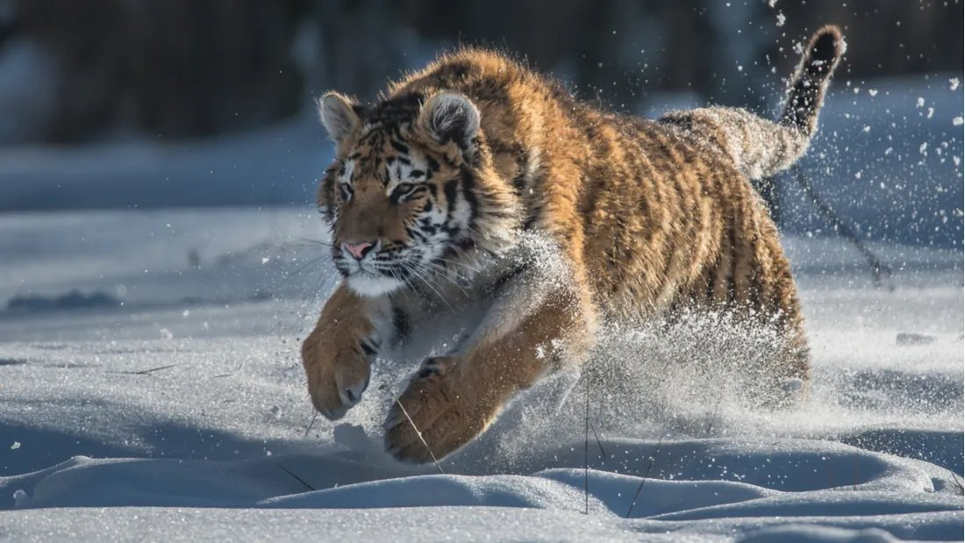
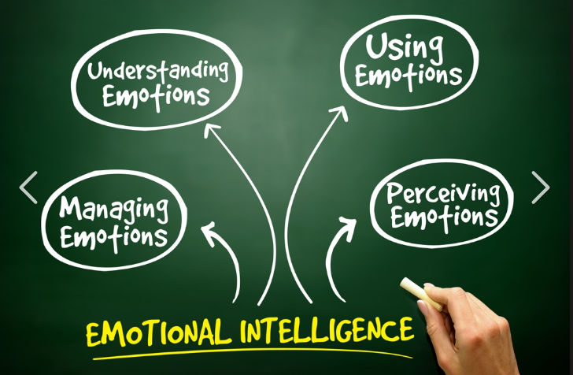

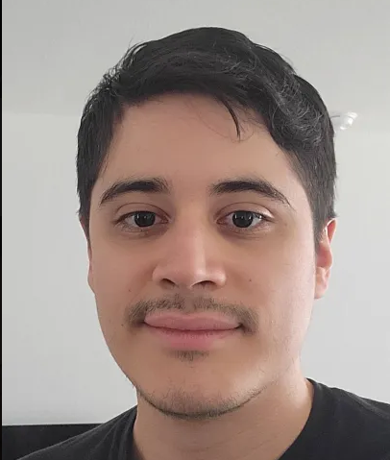
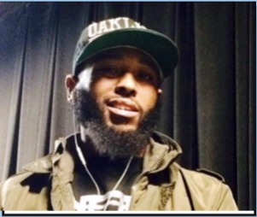
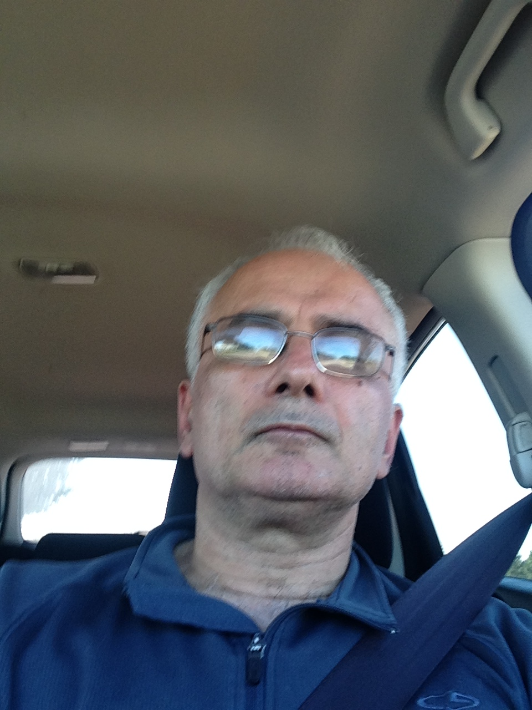
Motto
Visionary
Team Tiger
Music
Strength
Emotional Intelligent
Tyyotalle Germain
Jose Moreno
Eric Smith
Olis Bahari
W218484458@student.hccs.edu
W216039977@student.hccs.edu
W218607880@student.hccs.edu
W218008034@student.hccs.edu

